Slide 1


Slide 2
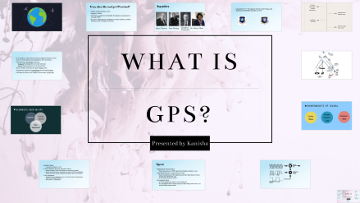

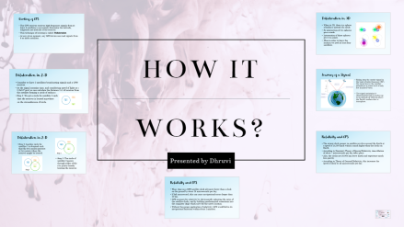


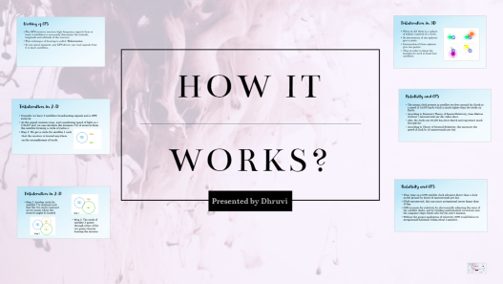
Quick Glance!

Slide 3

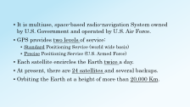
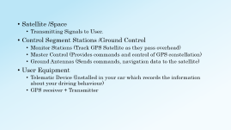

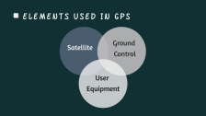
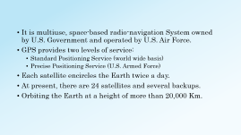
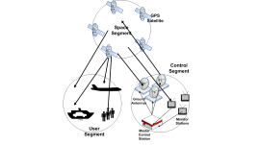

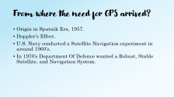


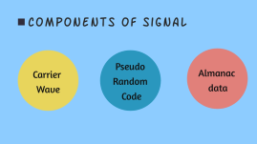
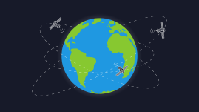
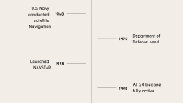
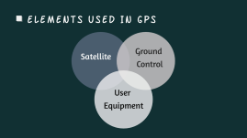
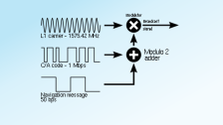

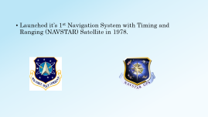


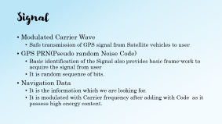
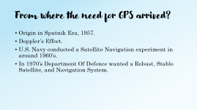


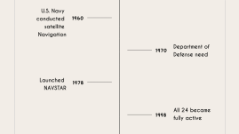



Slide 4


Slide 5
From where the need for GPS arrived?
Origin in Sputnik Era, 1957.
Doppler’s Effect.
U.S. Navy conducted a Satellite Navigation experiment in around 1960’s.
In 1970’s Department Of Defence wanted a Robust, Stable Satellite, and Navigation System.

Slide 6
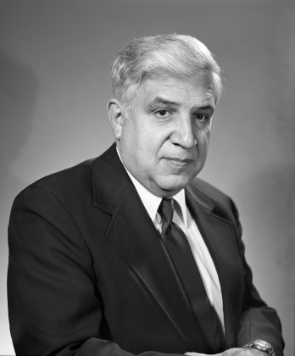
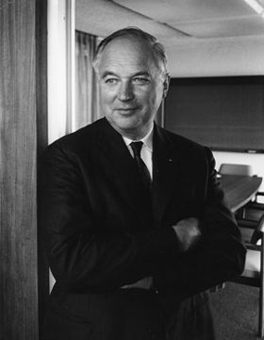
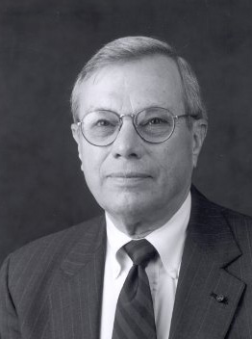

Inventors
Roger L Easton
Ivan Getting
BradFord
ParkinSon
Dr. Glady’s West

Slide 7

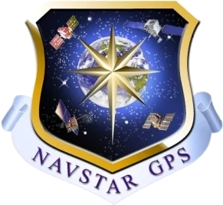
Launched it’s 1st Navigation System with Timing and Ranging (NAVSTAR) Satellite in 1978.

Slide 8
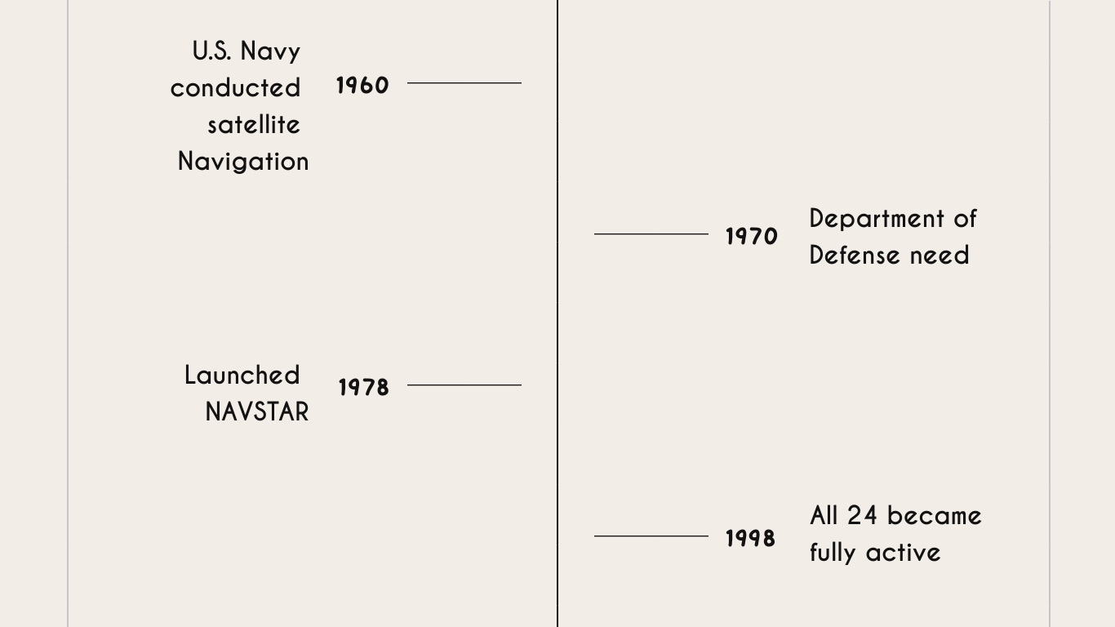

Slide 9
It is multiuse, space-based radio-navigation System owned by U.S. Government and operated by U.S. Air Force.
GPS provides two levels of service:
Standard Positioning Service (world wide basis)
Precise Positioning Service (U.S. Armed Force)
Each satellite encircles the Earth twice a day.
At present, there are 24 satellites and several backups.
Orbiting the Earth at a height of more than 20,000 Km.

Slide 10


Slide 11
Satellite /Space
Transmitting Signals to User.
Control Segment Stations /Ground Control
Monitor Stations (Track GPS Satellite as they pass overhead)
Master Control (Provides commands and control of GPS constellation)
Ground Antennas (Sends commands, navigation data to the satellite)
User Equipment
Telematic Device (Installed in your car which records the information about your driving behaviour)
GPS receiver + Transmitter

Slide 12
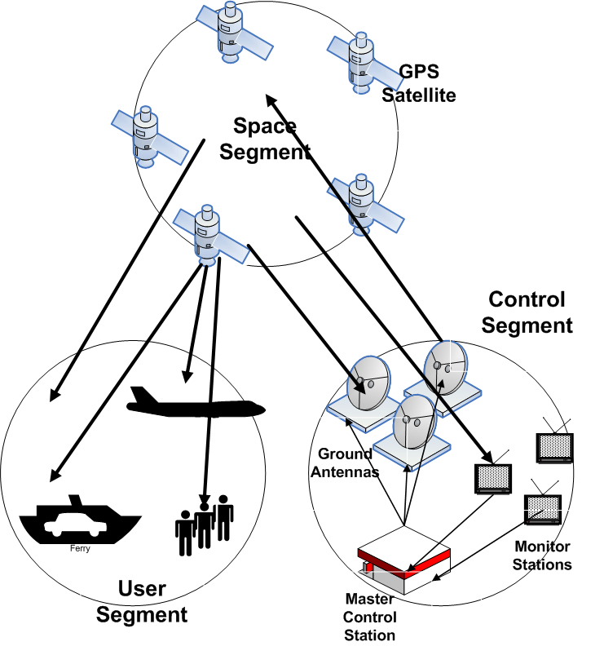

Slide 13


Slide 14
Signal
Modulated Carrier Wave
Safe transmission of GPS signal from Satellite vehicles to user
GPS PRN(Pseudo random Noise Code)
Basic identification of the Signal also provides basic frame-work to acquire the signal from user
It is random sequence of bits.
Navigation Data
It is the information which we are looking for.
It is modulated with Carrier frequency after adding with Code as it possess high energy content.

Slide 15
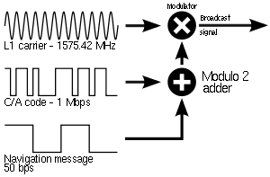

Slide 16

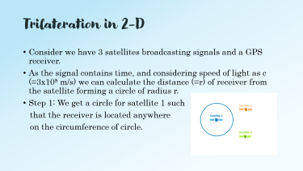
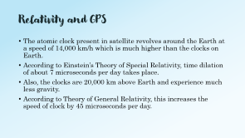
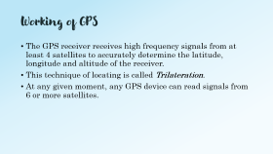
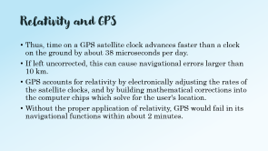
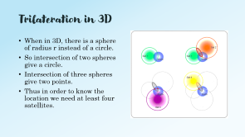

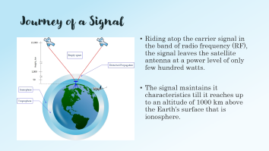

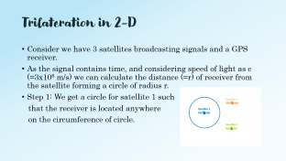
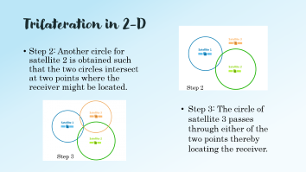



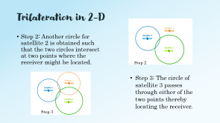



Slide 17
Working of GPS
The GPS receiver receives high frequency signals from at least 4 satellites to accurately determine the latitude, longitude and altitude of the receiver.
This technique of locating is called Trilateration.
At any given moment, any GPS device can read signals from 6 or more satellites.

Slide 18
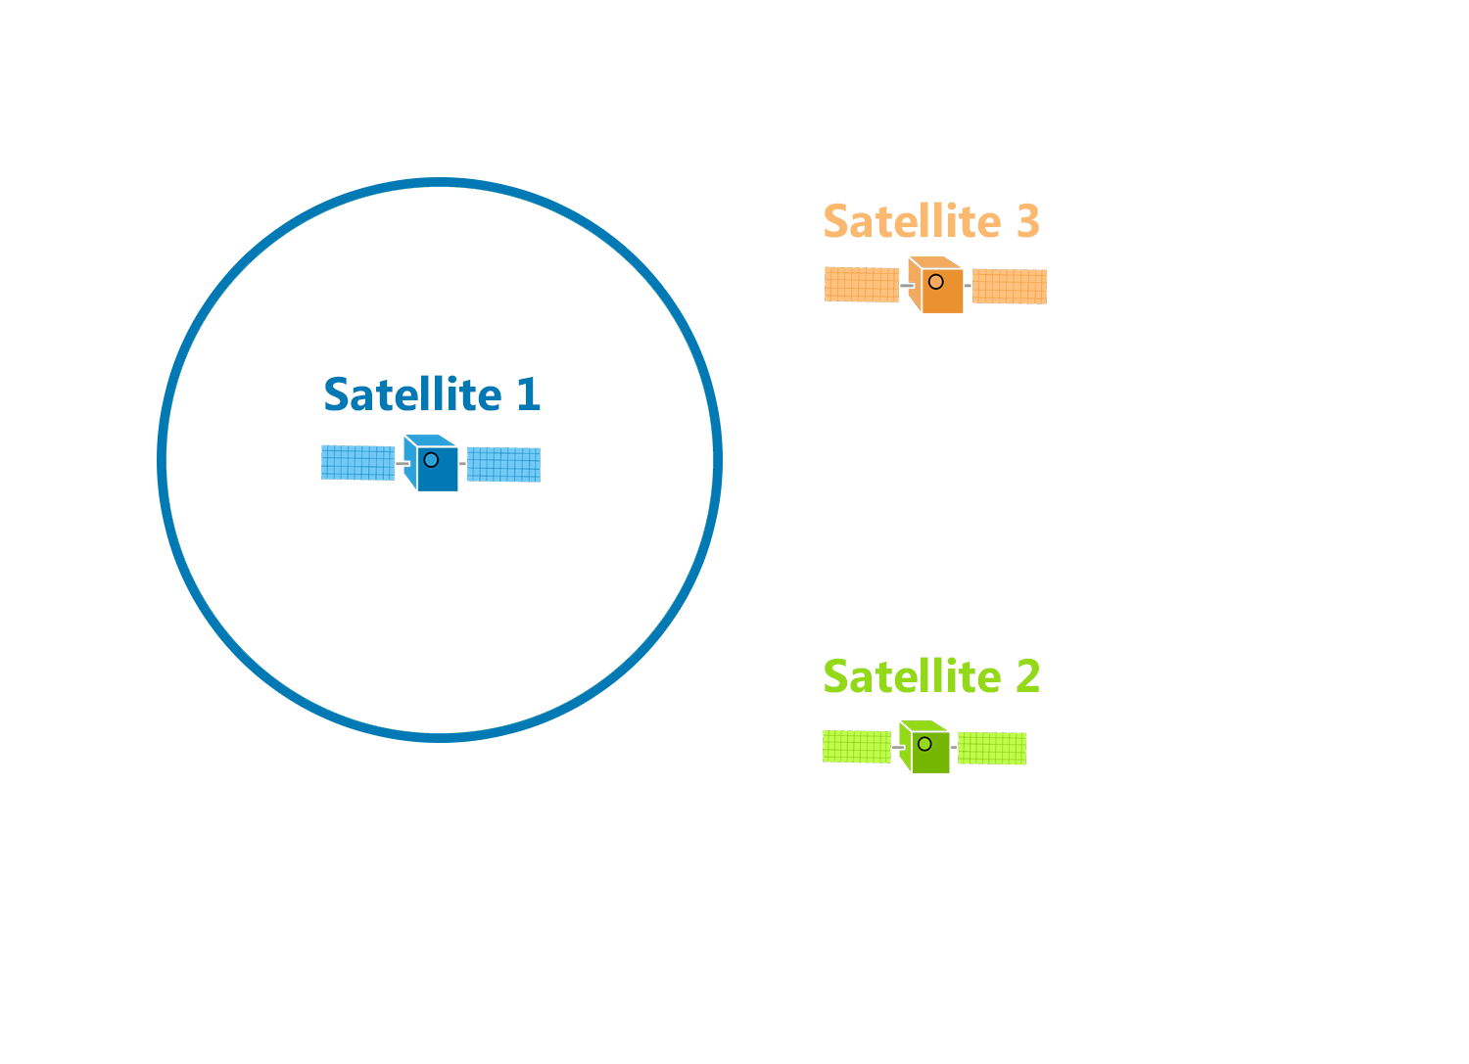
Trilateration in 2-D
Consider we have 3 satellites broadcasting signals and a GPS receiver.
As the signal contains time, and considering speed of light as c (=3x10⁸ m/s) we can calculate the distance (=r) of receiver from the satellite forming a circle of radius r.
Step 1: We get a circle for satellite 1 such
that the receiver is located anywhere
on the circumference of circle.

Slide 19
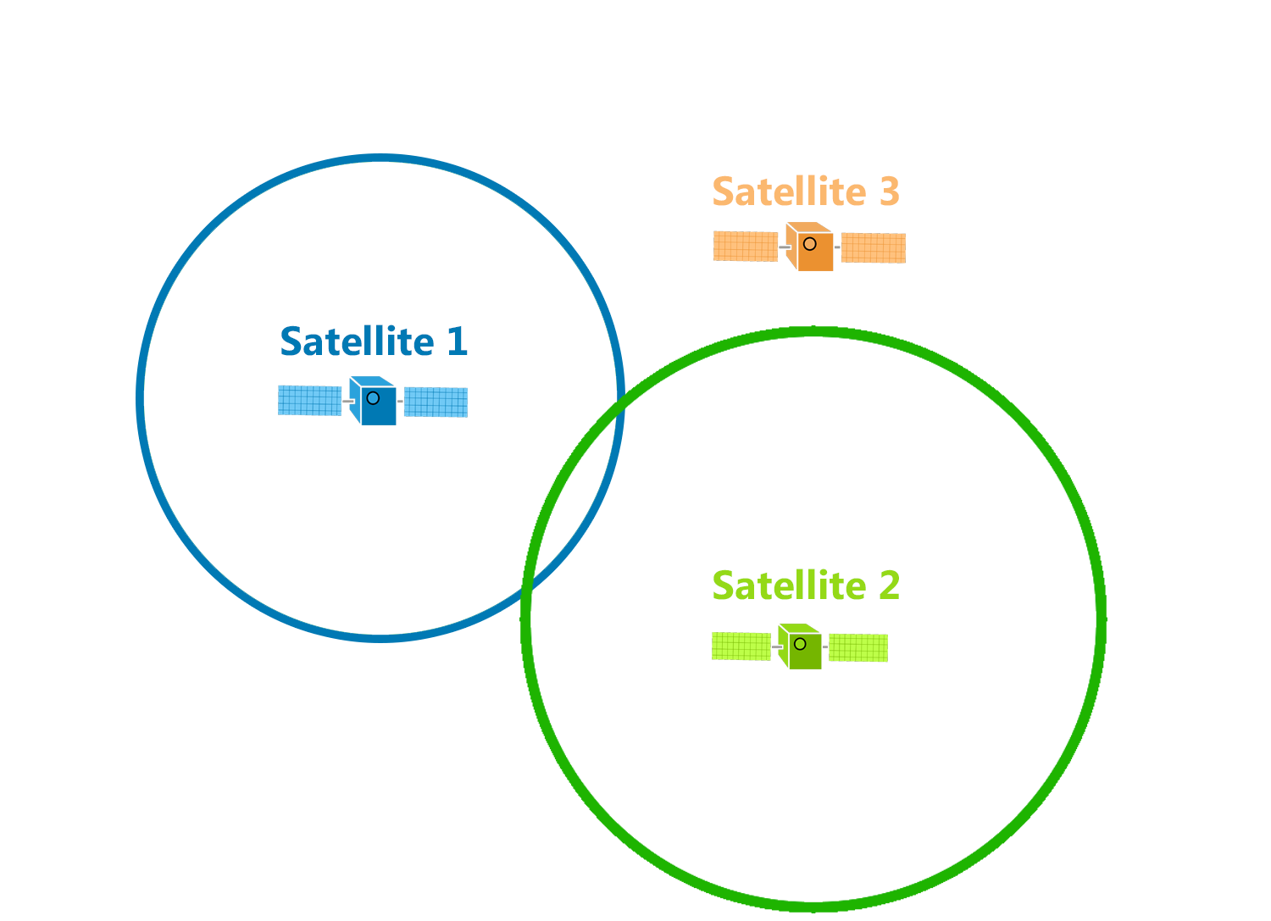
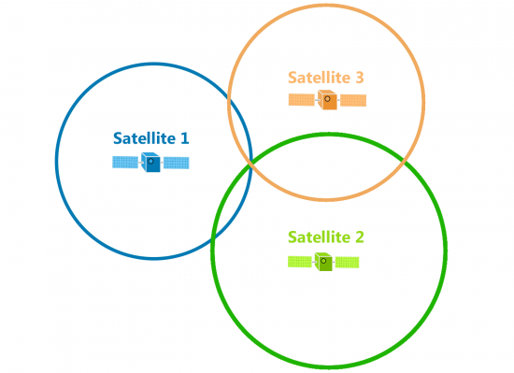
Trilateration in 2-D
Step 2: Another circle for satellite 2 is obtained such that the two circles intersect at two points where the receiver might be located.
Step 2
Step 3: The circle of satellite 3 passes through either of the two points thereby locating the receiver.
Step 3

Slide 20
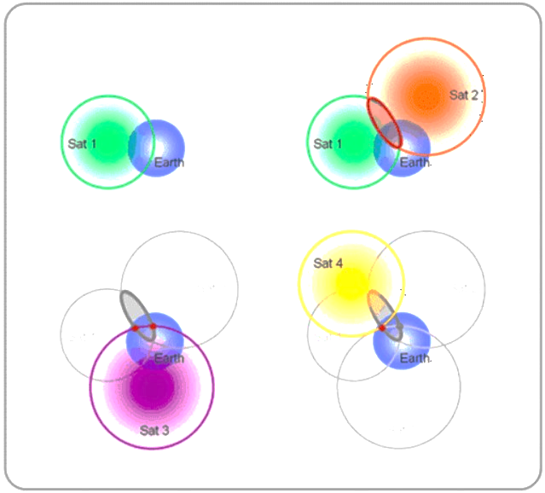
Trilateration in 3D
When in 3D, there is a sphere of radius r instead of a circle.
So intersection of two spheres give a circle.
Intersection of three spheres give two points.
Thus in order to know the location we need at least four satellites.

Slide 21
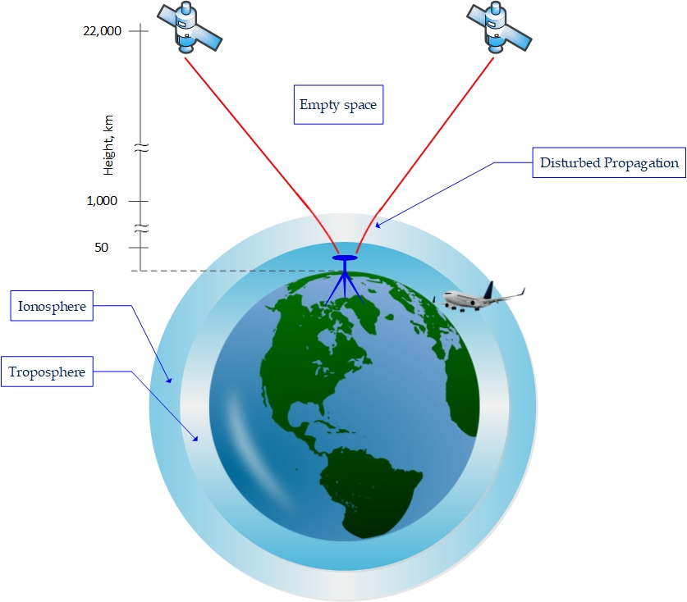
Journey of a Signal
Riding atop the carrier signal in the band of radio frequency (RF), the signal leaves the satellite antenna at a power level of only few hundred watts.
The signal maintains it characteristics till it reaches up to an altitude of 1000 km above the Earth’s surface that is ionosphere.

Slide 22
Relativity and GPS
The atomic clock present in satellite revolves around the Earth at a speed of 14,000 km/h which is much higher than the clocks on Earth.
According to Einstein’s Theory of Special Relativity, time dilation of about 7 microseconds per day takes place.
Also, the clocks are 20,000 km above Earth and experience much less gravity.
According to Theory of General Relativity, this increases the speed of clock by 45 microseconds per day.

Slide 23
Relativity and GPS
Thus, time on a GPS satellite clock advances faster than a clock on the ground by about 38 microseconds per day.
If left uncorrected, this can cause navigational errors larger than 10 km.
GPS accounts for relativity by electronically adjusting the rates of the satellite clocks, and by building mathematical corrections into the computer chips which solve for the user's location.
Without the proper application of relativity, GPS would fail in its navigational functions within about 2 minutes.

Slide 24

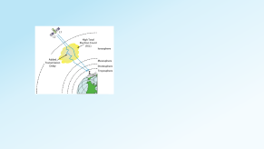
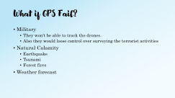
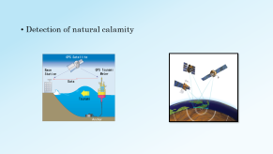
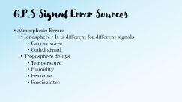
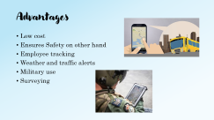
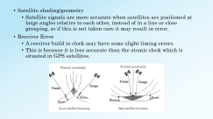
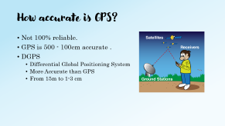

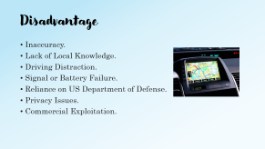

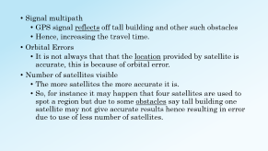

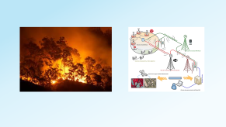



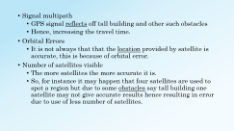




Slide 25

How accurate is GPS?
Not 100% reliable.
GPS is 500 - 100cm accurate .
DGPS
Differential Global Positioning System
More Accurate than GPS
From 15m to 1-3 cm

Slide 26
G.P.S Signal Error Sources
Atmospheric Errors
Ionosphere - It is different for different signals
Carrier wave
Coded signal
Troposphere delays
Temperature
Humidity
Pressure
Particulates

Slide 27


Slide 28
Signal multipath
GPS signal reflects off tall building and other such obstacles
Hence, increasing the travel time.
Orbital Errors
It is not always that that the location provided by satellite is accurate, this is because of orbital error.
Number of satellites visible
The more satellites the more accurate it is.
So, for instance it may happen that four satellites are used to spot a region but due to some obstacles say tall building one satellite may not give accurate results hence resulting in error due to use of less number of satellites.

Slide 29

Satellite shading/geometry
Satellite signals are more accurate when satellites are positioned at large angles relative to each other, instead of in a line or close grouping, so if this is not taken care it may result in error.
Receiver Error
A receiver build in clock may have some slight timing errors.
This is because it is less accurate than the atomic clock which is situated in GPS satellites.

Slide 30
What if GPS Fail?
Military
They won’t be able to track the drones.
Also they would loose control over surveying the terrorist activities
Natural Calamity
Earthquake
Tsunami
Forest fires
Weather forecast

Slide 31



Slide 32


Advantages
Low cost
Ensures Safety on other hand
Employee tracking
Weather and traffic alerts
Military use
Surveying

Slide 33


Detection of natural calamity

Slide 34

Disadvantage
Inaccuracy.
Lack of Local Knowledge.
Driving Distraction.
Signal or Battery Failure.
Reliance on US Department of Defense.
Privacy Issues.
Commercial Exploitation.

Slide 35
References
https://en.wikipedia.org/wiki/GPS_signals#Precision_code
https://en.wikipedia.org/wiki/Differential_GPS
https://en.wikipedia.org/wiki/Global_Positioning_System
https://www.nap.edu/read/9254/chapter/5#7
https://www.gps.gov/

Slide 36
Thank you

